Slide 1
SAP BTP Extension Suite Training
Day 20
Anubhav Oberoy
www.AnubhavTrainings.com
Follow excellence with sheer passion

Slide 2


DISCLAIMER
The training content and delivery of this presentation is confidential, and cannot be recorded, or copied and distributed to any third party, without the written consent of Anubhav Trainings

Slide 3
Agenda – Day 20
01
Scenario 1: UI Extension
02
S4 Cloud SDK
03
Scenario 2: CAP extension

Slide 4
Hands on: Create Display like App for Sales Order
Enabling an OData API on SAP S/4HANA
Setting up SAP Cloud Connector and S/4HANA for principal propagation
Setting up an SAP BTP BAS Subscription
Developing of a simple Fiori Application with the SAP Business Application Studio
Deploying the application to the HTLM5 repository service
Integrating he application into the Launchpad service
Destination service – to read the destination from SAP BTP at runtime for the purpose of connection
Connectivity service – once the destination is read, it will use connectivity service to connect to our oData source
HTML5 deployer – this will be used to deploy our app to HTML5 repository.
HTML5 Repo Runtime – Will load the Fiori app when requested at runtime.
Fiori launchpad service – which displays Fiori apps as a tile.

Slide 5
Scenario 2:
Own Fiori App
SAP or Non SAP API OData which we want to reuse
Android App
SAP UI5 App
CAPM App
Middleware
Data manipulation, enrichment, Security, automation, movement, proxy
HANA

Slide 6
Hands on: Initialize CAPM Extension
Create a new cap project with cds init
Drag drop edmx file downloaded from API hub and perform cds import PATH_OF_EDMX
Add a new CatalogService.cds and CatalogService.js
S4HANA cloud sdk is SAP’s portfolio of all the type safe API (node modules) to communicate to SAP APIs.
Install the node module @sap/cloud-sdk-vdm-sales-order-service
Add the configuration to test our api locally – credentials

Slide 7
Hands on: Initialize CAPM Extension
Create a new folder and initialize cap project using cds init
Go inside project and install following modules
  2.1 Cloud Foundry Security - @sap/xssec, @sap/xsenv, passport
  2.2 OData V2 @sap/cds-odata-v2-adapter-proxy
  2.3 Serving odata v2 over cloud sdk - @sap-cloud-sdk/odata-v2
  2.4 To generate the service code in node js, install cloud sdk generator module using @sap-cloud-sdk/generator
3. Create a new folder service-spec, and cds watch, after that drag drop the edmx file of our service to the folder. It will create external folder
4. Generate the JS code to automatically get all the calls which will call the service
npx generate-odata-client --input ./service-spec --outputDir ./srv/sales-order-api
Give the folder path, not the edmx file path
5. Define the service definition in CatalogService.cds file by referencing from csn file generated based on SAP OData
6. Define the service implementation CatalogService.js file and write the code to use the generated type script modules which will act like bridge to communicate to our SAP OData Business API.
7. Generate a Fiori application using free style with local cap project.

Slide 8
Hands on Cloud Extension
8. Replace hardcoded credentials with destination
9. Create a destination service and maintain destination with name S4HANA because the same we used in our code.
10. Create mta.yaml file for deployment
11. Add the modules, both srv and ui module.
12. Add Resources as destination and xsuaa. Maintain the xs-security.json file
13. Get the package json in app folder from ui project, Add the app router module @sap/approuter and include start script.
14. xs-app.json file for routing paths
15. Push the code to the github
16. You can pull the app in BAS tool, Right click on mta.yaml and build MTA Archieve
17. Once done, right click and deploy MTA_Archieve to SAP BTP

Slide 9
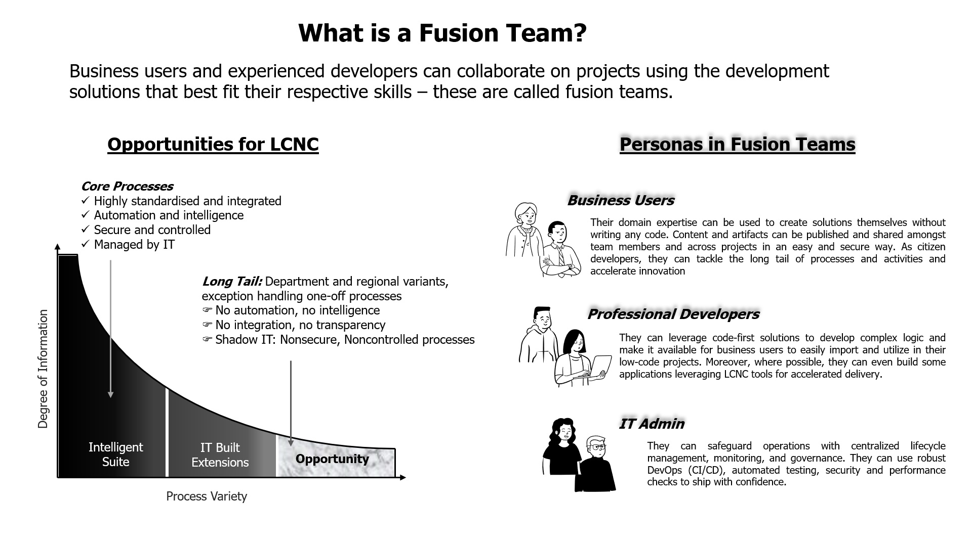
What is fusion Team?

Slide 10
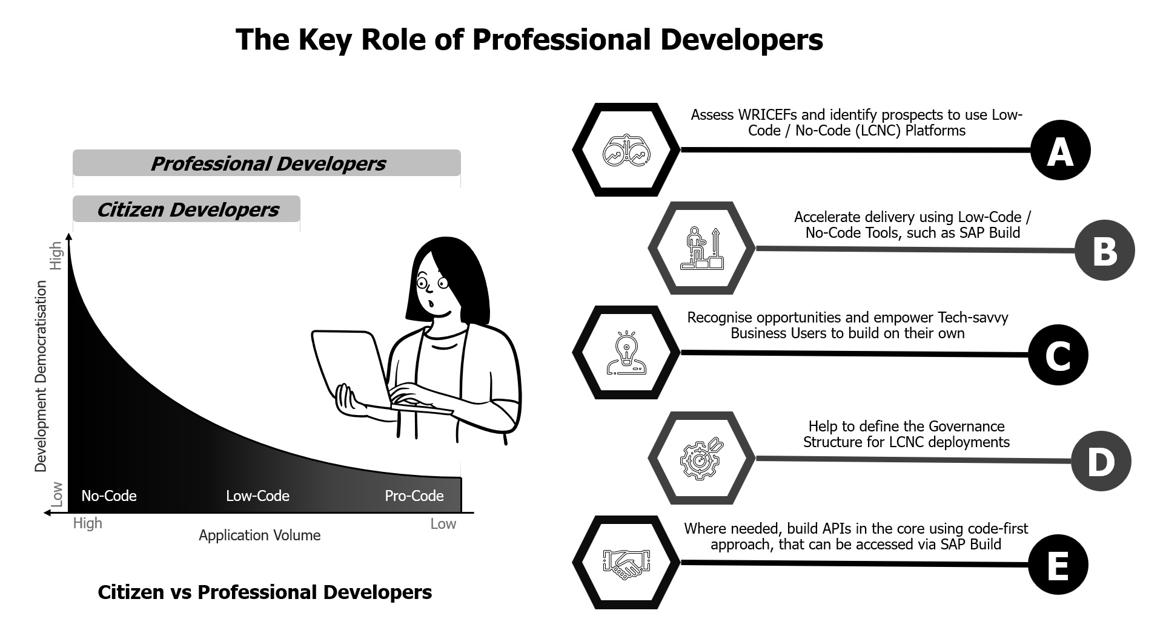
Key role of professional developers?

Slide 11
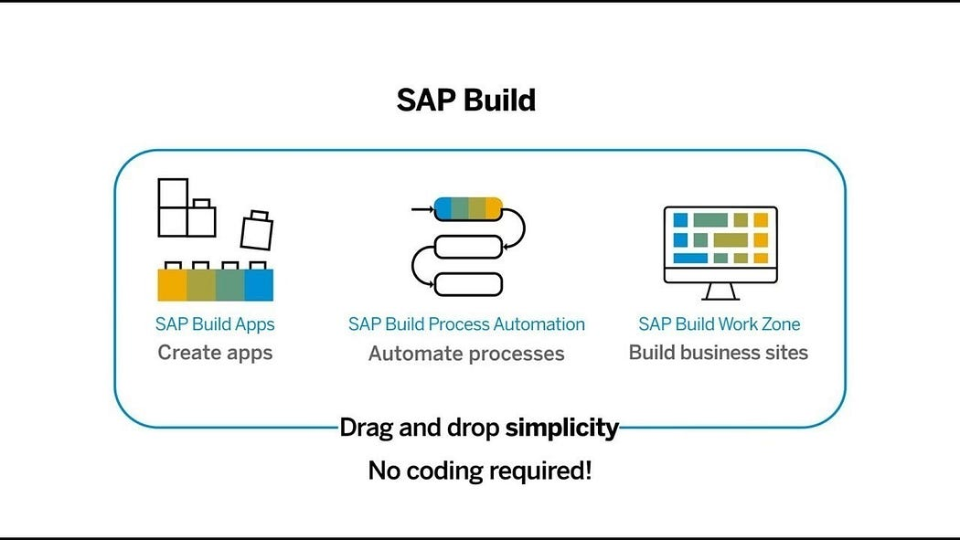
What is SAP Build?
SAP Build is a user-friendly low-code/no-code platform within the SAP Business Technology Platform (SAP BTP), designed to empower users to create, customize, and enhance applications, automate workflows, and build business sites without the need for advanced coding skills. It includes three primary components:

Slide 12
SAP Build Offerings?
SAP Build Process Automation
SAP Build WorkZone
SAP Build Apps
Purpose: Simplify the development of enterprise applications through an intuitive interface.
Key Features:
Visual Development: Create UI, workflows, and logic using a drag-and-drop approach.
Prebuilt Templates: Leverage templates for common business scenarios.
Data Integration: Connect seamlessly with SAP and external systems through APIs.
Multi-Channel Deployment: Develop apps for both web and mobile platforms.
Collaboration Tools: Facilitate teamwork during the app-building process.
Use Cases:
Developing HR onboarding solutions.
Building custom KPI tracking dashboards.
Creating customer-facing applications for feedback collection.
Purpose: Streamline business processes using workflows and robotic process automation (RPA).
Key Features:
Workflow Automation: Manage approvals, notifications, and document routing automatically.
Prebuilt Bots: Access a library of bots to handle repetitive tasks like data entry.
Business Rules Management: Easily define and update business logic.
Process Visibility: Track and optimize workflows in real-time.
AI Integration: Utilize AI capabilities such as document recognition for enhanced automation.
Use Cases:
Automating invoice approval workflows.
Managing employee leave requests.
Connecting and streamlining repetitive processes across systems.
Purpose: Design tailored business sites and portals for employees, customers, or partners.
Key Features:
Prebuilt Templates: Quickly create branded portals.
Content Integration: Combine apps, dashboards, and workflows in a unified portal.
Role-Based Access: Customize content and permissions according to user roles.
Collaboration Features: Incorporate chat, forums, and knowledge-sharing tools.
Mobile-Friendly Design: Ensure accessibility across all devices.
Use Cases:
Developing employee self-service platforms.
Creating customer support portals.
Building collaboration hubs for partners.

Slide 13
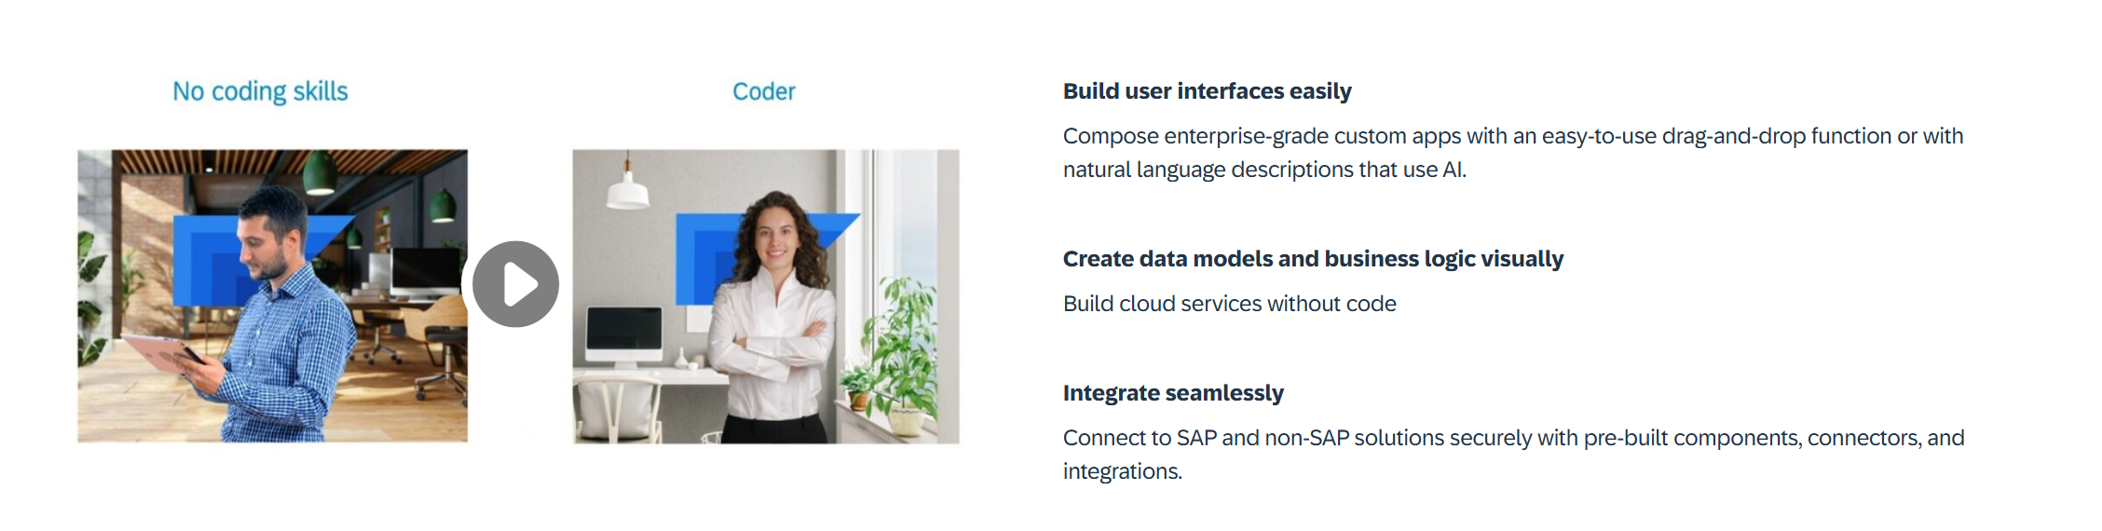
What is Build Apps?
SAP Build Apps is an AI-infused professional application development solution designed for anyone to quickly create apps without code regardless of role or skill level.

Slide 14
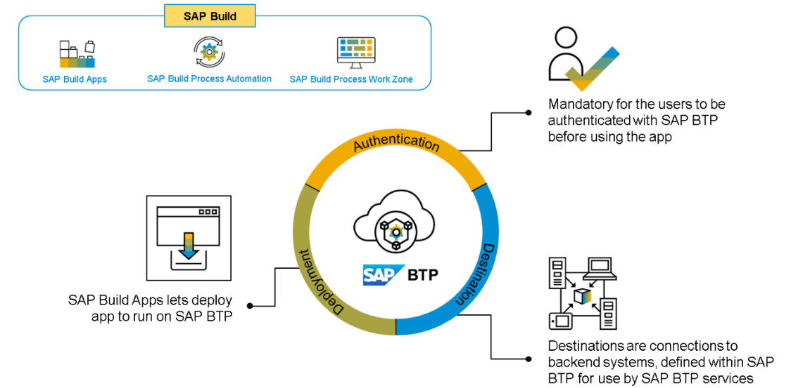
Core Capabilities?
Build Visually – SAP Build Capabilities enable customers to build visually, using drag-and-drop tools and intuitive interfaces. This allows users to quickly and easily design, configure, and deploy applications with no coding. By leveraging the SAP Build capabilities, customers can quickly create rich, interactive applications that streamline business processes, drive greater efficiency, and reduce operational costs. The tools are designed to be easy to use and are backed by a comprehensive library of pre-configured components, integration APIs, and data connectors.
Integrate Seamlessly – SAP Build capabilities help customers integrate their SAP solutions, applications, and systems with each other and with other systems and applications.
Collaborate Effectively – With its feature of seamless integration, SAP Build helps businesses leverage technologies like cloud-based tools with development teams to establish communication protocols like lifecycle management and built-in governance.

Slide 15
SAP BTP Build Process Automation
SAP Build Process Automation is a citizen developer solution to adapt, improve, and innovate business processes with no-code workflow management and robotic process automation capabilities.
SAP Build Process Automation enables business users and technologists to become citizen developers. With powerful yet intuitive low-code and no-code capabilities, the solution supports you in driving automation by tapping into the expertise of citizen developers.
Features
Build or adapt processes with an intuitive graphical interface.
Create forms-based workflows using drag-and-drop functionality.
Develop and manage decision logic in tabular, spreadsheet-like decision tables.
Automate repetitive tasks within existing process flows using robotic process automation.
Create intelligent actions and recommendations using machine learning capabilities.
Work efficiently from a unified launchpad and task center.
Hand over projects to professional developers, who can embed actions and advanced workflows into projects initiated by citizen developers.
Support real-time, event-driven transparency into comprehensive processes and process instances with process visibility dashboards.
In addition, SAP Build Process Automation offers prebuilt content and features – such as bots, process steps, business rules, and workflow components.

Slide 16
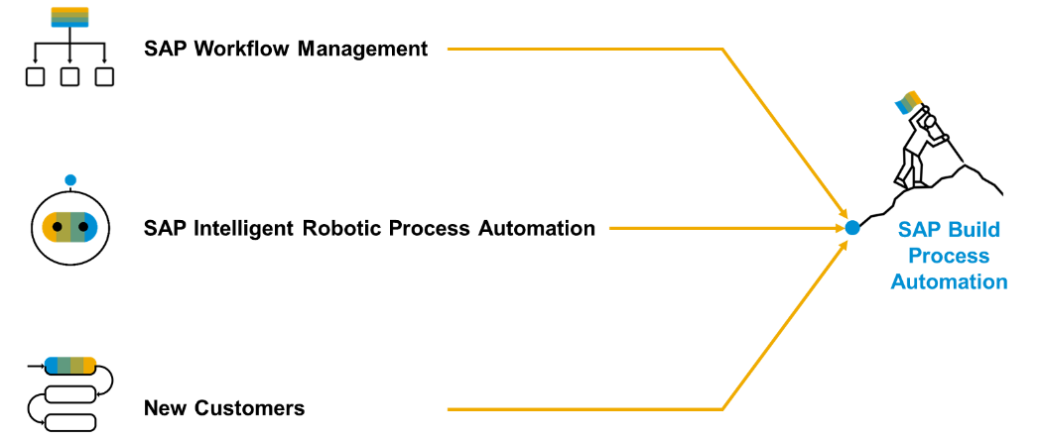
Product Overview
SAP Build Process Automation is a solution that evolved out of the former stand-alone SAP products - SAP Workflow Management and SAP Intelligent Robotic Process Automation. It provides a new citizen developer experience that didn't exist in either of the two former products.
As you or your company might have used SAP Workflow Management or SAP Intelligent Robotic Process Automation in the past, you are looking for a path into the joined solution. Fortunately, SAP Build Process Automation is fully compatible with all workflow and automation artifacts that you have created.

Slide 17

What We Did
Let’s Summarize

Slide 18

www.anubhavtrainings.com
Thank You
End of Day 20

Slide 19


We’re committed to empower you to be
#FutureReady
through powerful training solutions.
We build the workforce of the future.
260+
Corporate Clients
60,000+
Learners Trained
26000+
Learners Placed
FREE WEBINARS
Sign up for free webinars with industry experts every fortnight!
Enroll Now!
Contact us today!
https://anubhavtrainings.com

